Slide 1

Accidents in weather
Samantha sommer, Ashley Aguayo, seth lynes

Slide 2
Motivation and Summary
Our group was interested to see if there was a correlation between weather and accidents in Maricopa County. We believe they are correlated but wanted to study the data to analyze the data that may support our hypothesis. We wanted to see if the high temperatures and occasional rain would lead to more accidents compared to average weather.
We were able to answer our question, but not to our satisfaction. We would have preferred to have more years of data compared the one year we had. We were surprised none of our original thoughts with data were correct.

Slide 3
Questions?
Does weather have an effect on traffic accidents?
Is there a more dangerous season/weather type to drive in?
Where have most of the accidents occurred?
Correlation between high temperatures and traffic accidents?

Slide 4
Data
We found U.S. data accident data from Kaggle.com and we focused on Maricopa County in Arizona for 2020.
We used a csv file from AZMET weather data to look at Maricopa County weather in 2020.
Originally brought in 2019-2020 accident data, but we then realized there were only 3 months in the 2019 data and had to pivot to the 2020 data. The U.S. accident file had weather information but only for the days accidents occurred.

Slide 5
Data Exploration and Cleanup
Pull in the csv for all U.S Accidents, specifically in Arizona
Pulled in the columns relevant to our questions
Dropped data that did not have details related to the accidents
Searched for Maricopa County accidents only
Updated the start time and end time columns to date format, added extra columns to separate by day, month, year, and seasons.
Filtered the data to show accidents that occurred only in 2020
Brought in Maricopa weather csv file, added a column to group by month

Slide 6
Analysis Process
Analyzed accidents by season in Maricopa County, we wanted to know how many accidents there were per day, month, and season.
Analyzed average accidents and temperature per day, we compared the accident count against different weather conditions (temperature, precipitation, wind speed).
Analyzed the top 5 cities in Maricopa County with the most accidents.
Compared severity of accident with the weather condition at time of accident.
Analyzed which weekday had the most accidents in 2020.
Merged weather dataframe and accident dataframe to plot average weather vs number of accidents.

Slide 7
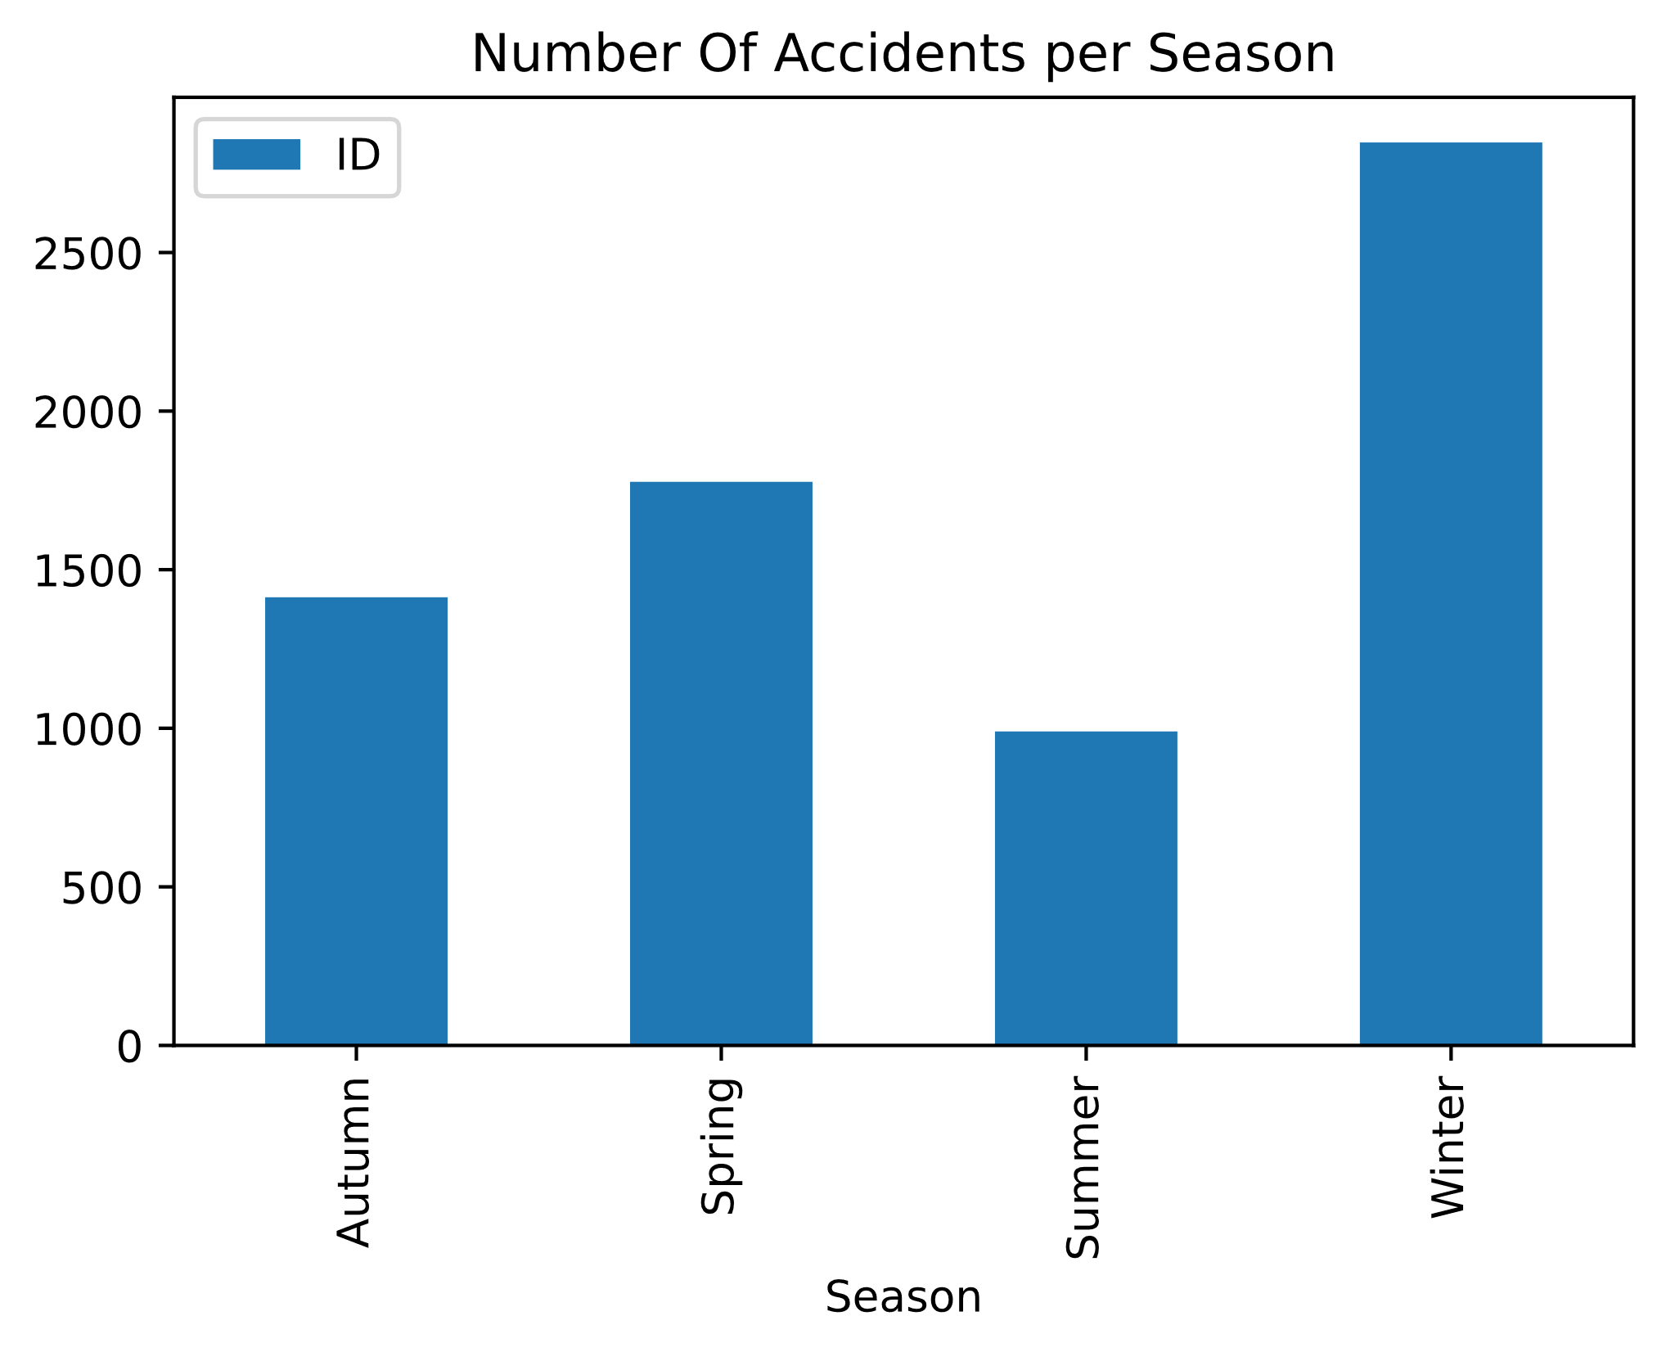
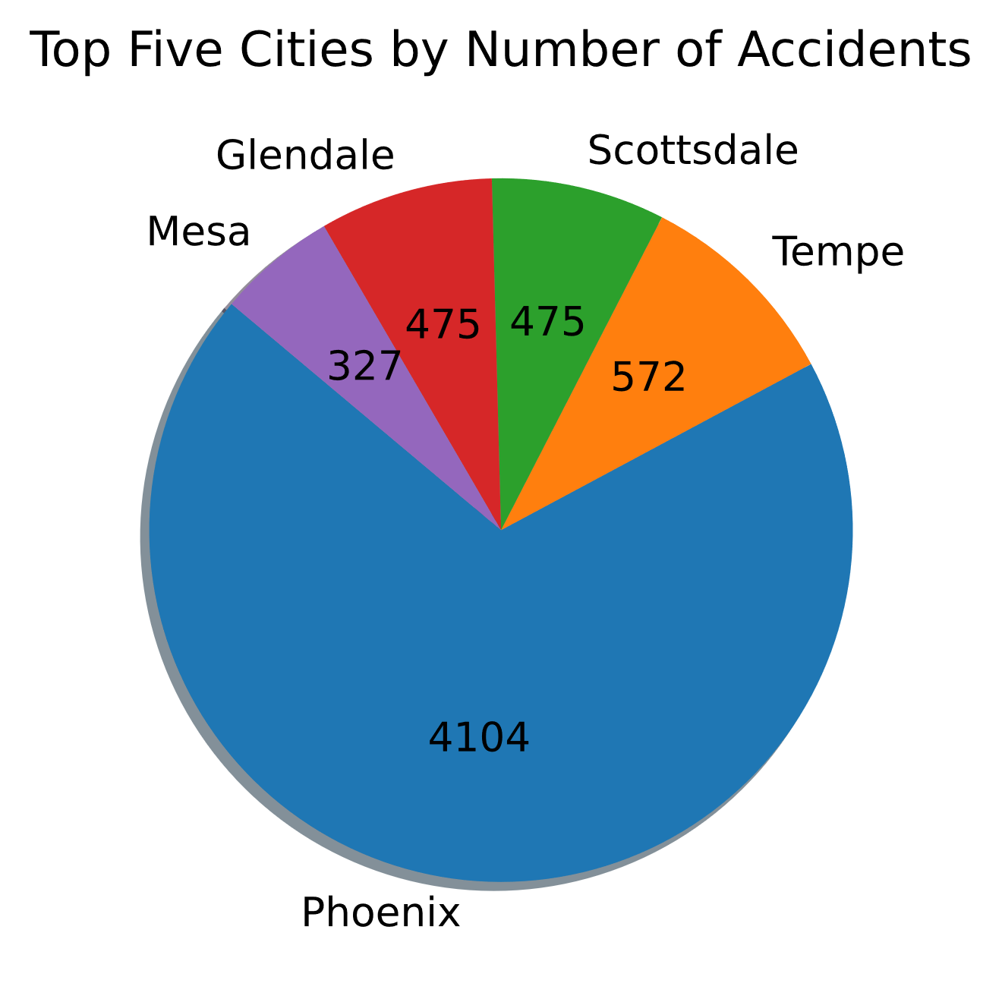
Graphs

Slide 8
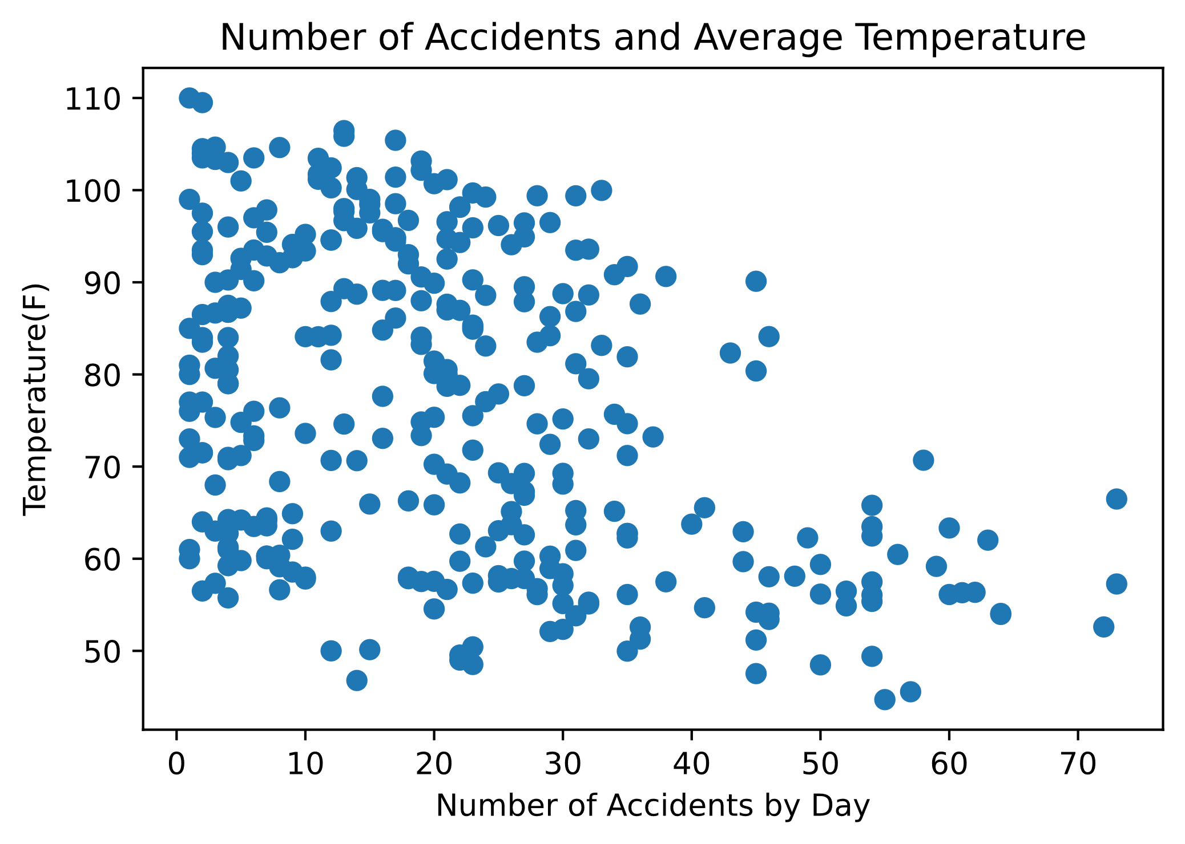
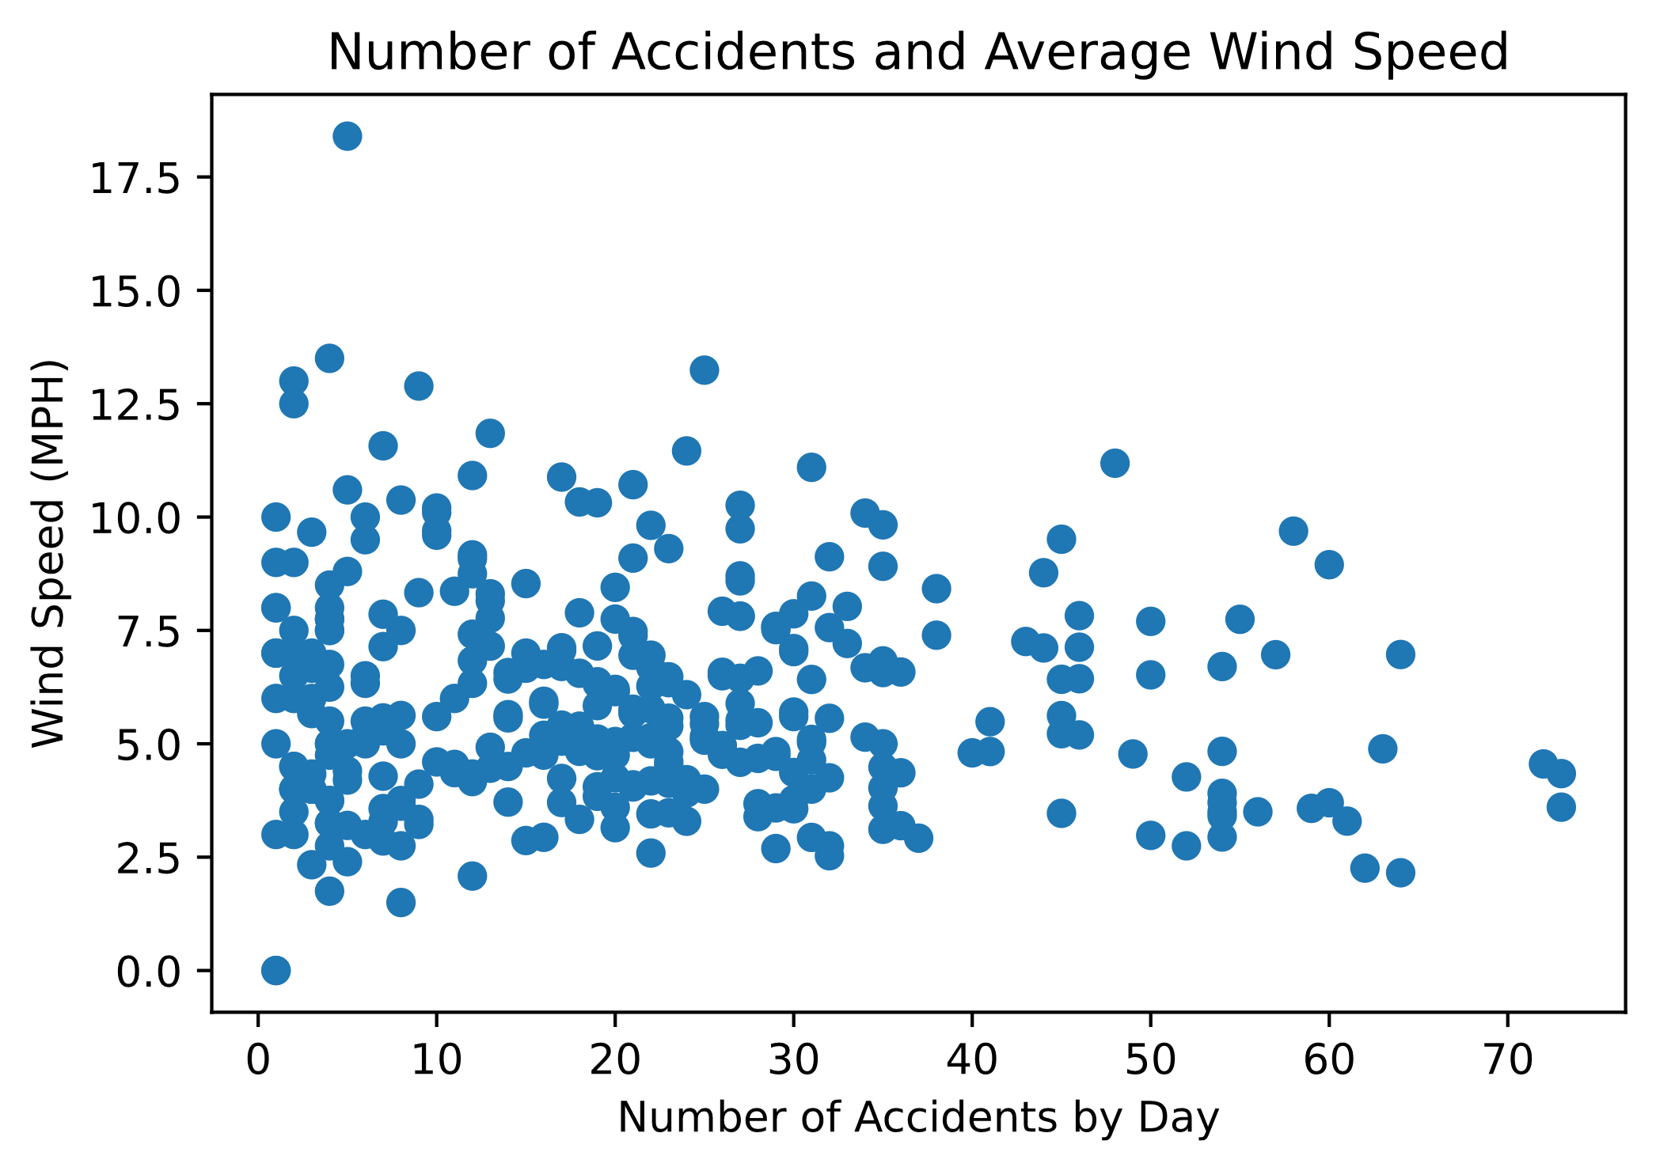
Graphs

Slide 9
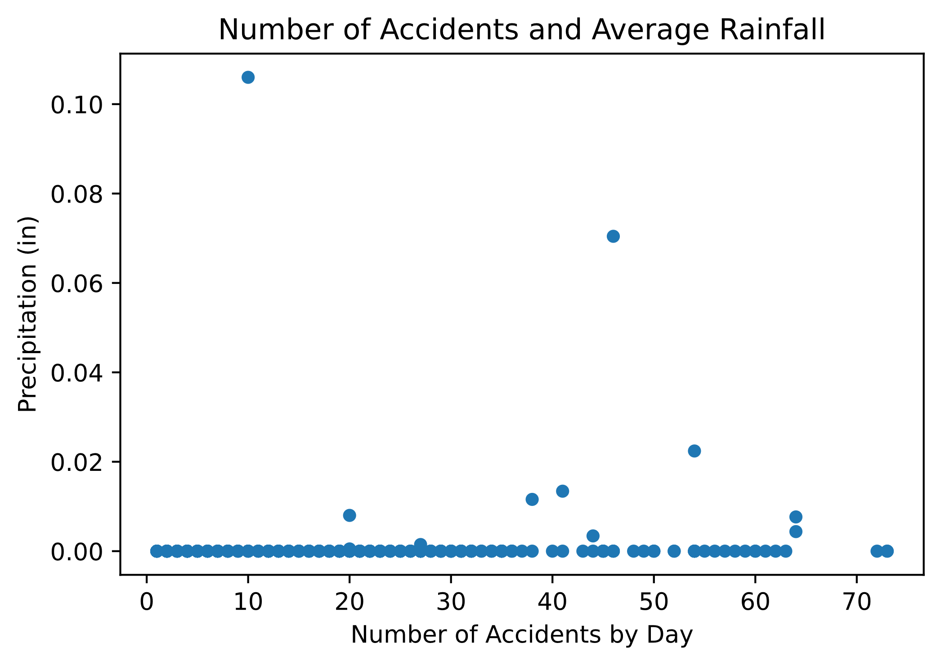
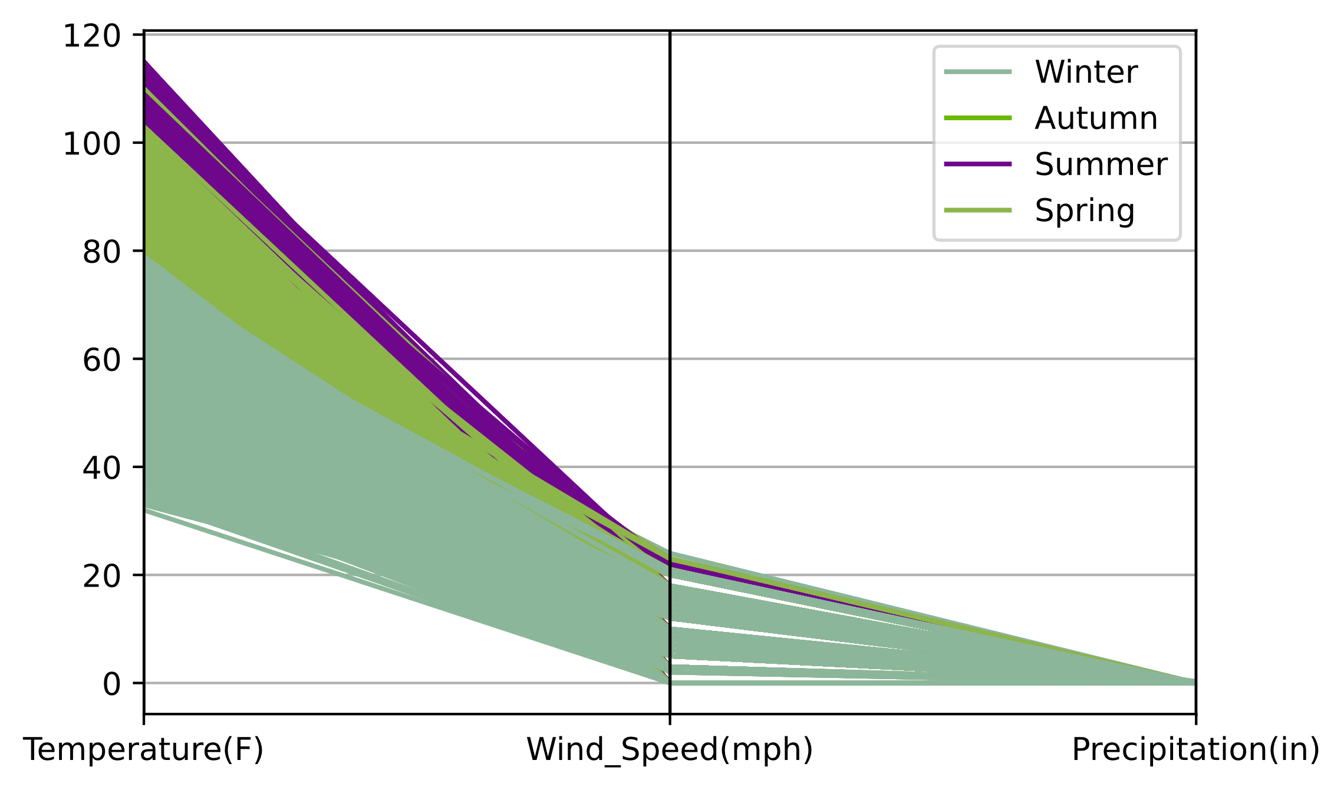
Graphs

Slide 10
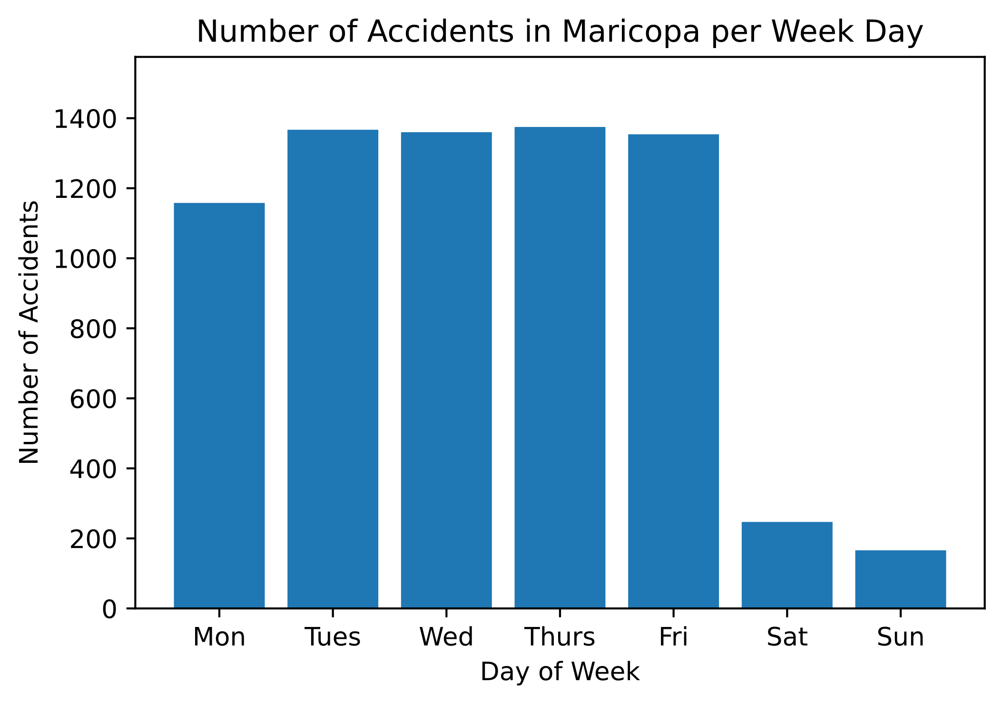
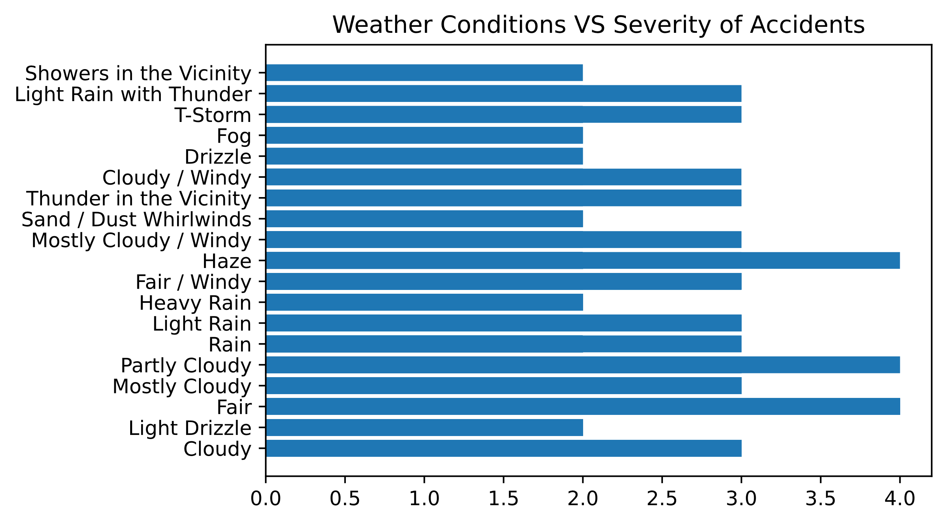
Graphs

Slide 11
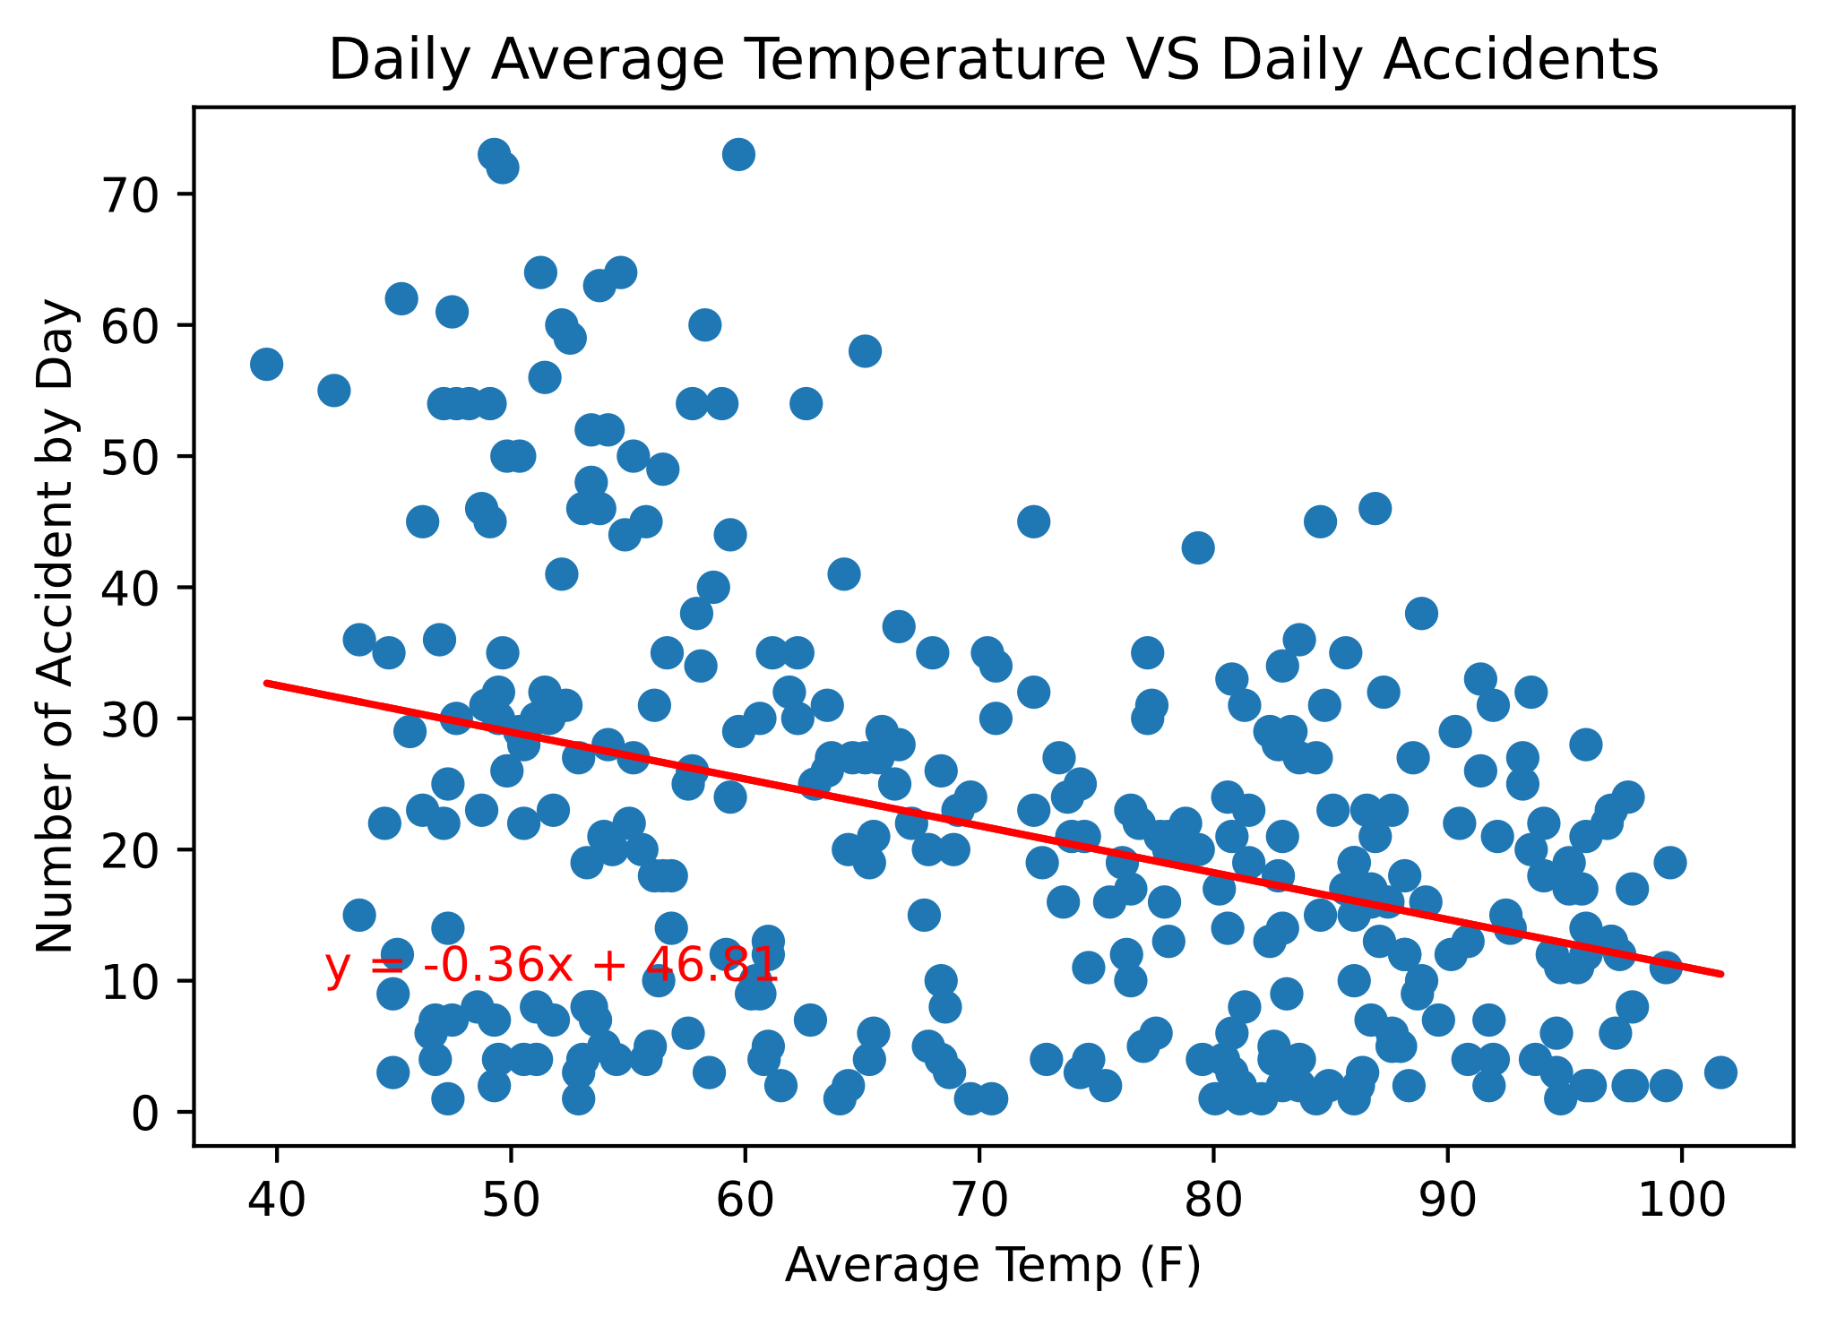
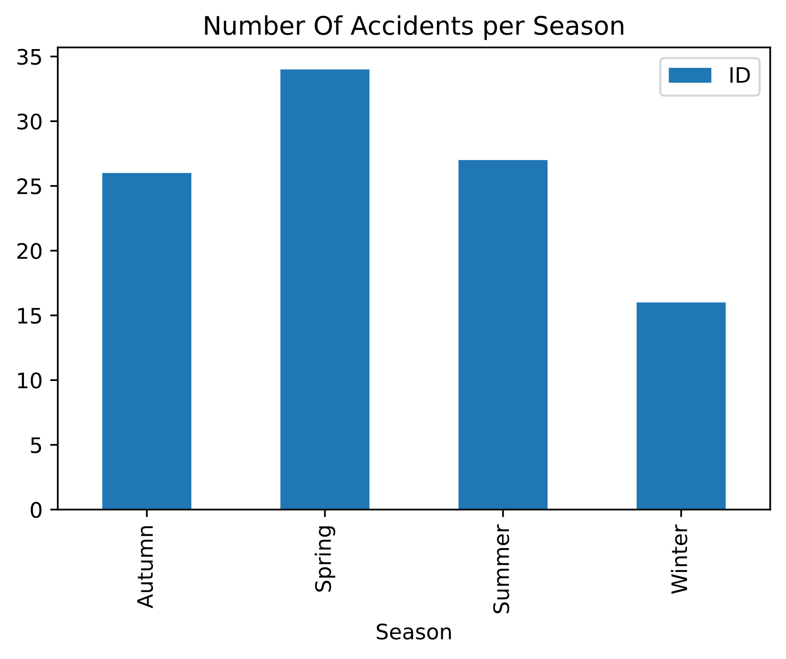
Graphs

Slide 12
Discussions
We found no correlation between extreme weather conditions and accidents in Maricopa County.
Our data may have been skewed due to the COVID pandemic, if we had more time we would have looked into more years to compare accidents.
Maricopa County doesn’t fluctuate in extreme weather and there were low amounts of precipitation in 2020, so most accidents happened in fair weather.

